Slide 1
Genetic Variants and Dyslipidemia
Dr. Kari North
09 December, 2016

Slide 2
Introduction
Dyslipidemia in children
Dyslipidemia is an important risk factor for chronic cardiometabolic diseases.
Dsylipidemia represents any abnormal levels of lipid, lipoprotein, or apolipoprotein factors (Kwiterovich 2008), including:
total cholesterol (TC)
low density lipoprotein cholesterol (LDL-C) triglycerides (TG)
high density lipoprotein choleseterol (HDL-C)

Slide 3
Introduction
Heritability of dyslipidemia
Lipid traits are heritable (h² can exceed 0.50) (Goode et al. 2007) and strongly associated with cardiovascular disease sustaining strong interest in genetic research.
By 2013, researchers have identified more than 150 established loci influencing lipid levels in adults (C. J. Willer et al. 2013).

Slide 4
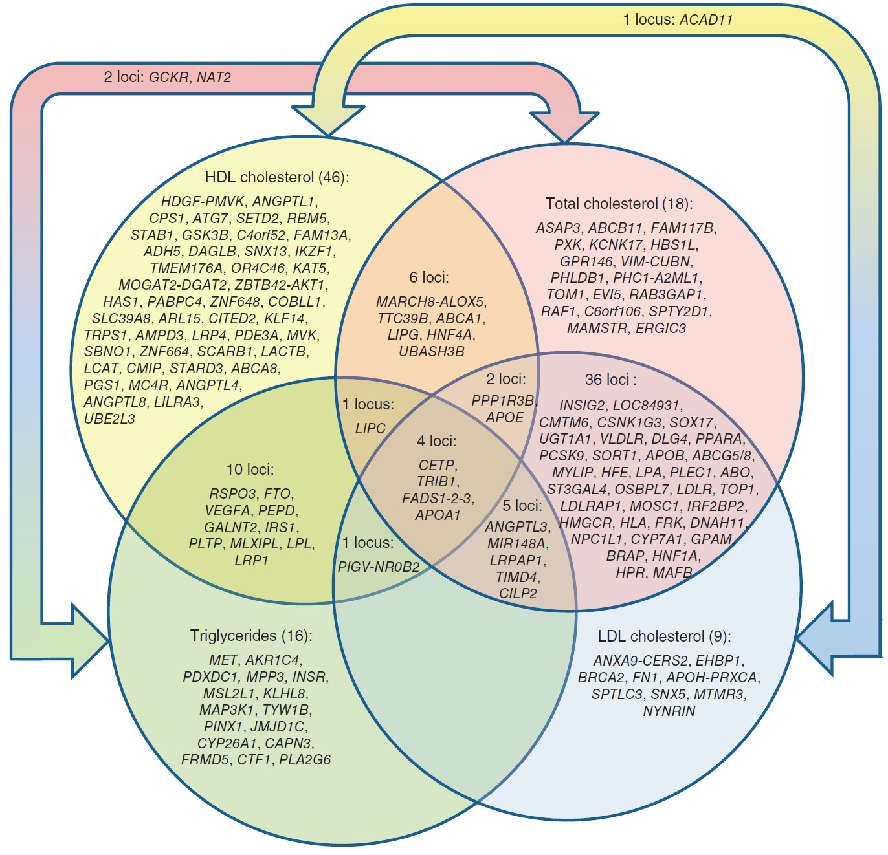
Introduction
Lipid variants

Slide 5
Source: Willer, C. J., Schmidt, E. M., Sengupta, S., Peloso, G. M., Gustafsson, S., Kanoni, S., Abecasis, G. R. (2013). Discovery and refinement of loci associated with lipid levels. Nature Genetics, 45(11), 1274–1283.
https://doi.org/10.1038/ng.2797

Slide 6
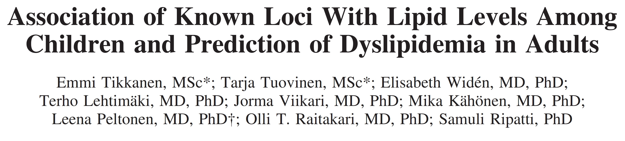
Introduction
Generalizability across ancestral groups
Results found for adults have been found to generalize to children in a Finnish population (Tikkanen et al. 2011; Buscot et al. 2016).
Certain variants that associate with a trait such as dyslipdemia in one ancestral group may not associate in other groups (Carlson et al. 2013).
Why? Differences across ancestral groups include:
Variant frequencies Linkage disequilibrium
No research exists examining the association between genetic variants and dyslipidemia in Hispanic/Latino (HL) children

Slide 7
Introduction
Primary Aim
Examine the association of known lipid variants with lipid traits identified in large study of adult participants from a Chilean infancy cohort of primarily European-descent.
Compare results to those found in a Finnish population.

Slide 8
Methods
Association tests
We assessed single variant associations using linear regression for high density lipoprotein cholesterol (HDL- C), low density lipoprotein cholesterol (LDL-C) and triglycerides (TG), assuming an additive genetic model, adjusted for sex and ancestry (via principal components).
Sample Model for HDL
HD = β + SN β + se β + ANCESTR β +
SN represents one SNP with “genotypes were coded as 0, 1, or 2 when directly genotyped or as a predicted allele dosage (range, 0–2)
when imputed.” (Tikkanen et al. 2011)
Only six variants from the Chilean sample met the a priori threshold of power > 0.8 to detect an association based on effect sizes from GWAS (T. M. Teslovich et al. 2010).

Slide 9
Methods
Polygenic risk scores
Regress phenotypes onto weighted trait-specific polygenic risk scores (PRS).
Sample model for HDL
HD = β + β PRS +
PRS for HDL-C
(0.48 * rs4660293 + 0.49 * rs2814944 + 0.59 * rs4731702 + 0.41 * rs2923084 + 0.4 * rs7134375 + 0.44 * rs7134594 + 1.45 * rs1532085 + 3.39 * rs3764261 + 0.45 * rs2925979 + 0.42 * rs4148008 + 0.39 * rs4129767 + 0.64 * rs737337 +
1.88 * rs1800961 + 0.93 * rs6065906 + 0.47 * rs1689800 + 0.61 * rs4846914 + 0.68 * rs12328675 + 0.46 * rs2972146
+ 0.49 * rs6450176 + 0.39 * rs605066 + 1.95 * rs1084651 + 1.21 * rs9987289 + 0.44 * rs2293889 + 0.65 * rs581080 + 0.94 * rs1883025 + 0.78 * rs3136441 + 0.86 * rs4759375 + 0.44 * rs4765127 + 0.61 * rs838880 + 0.39 * rs2652834 +
1.27 * rs16942887 + 0.48 * rs11869286 + 1.31 * rs7241918 + 0.42 * rs12967135 + 0.45 * rs7255436 + 0.83 * rs386000
+ 0.46 * rs181362 + 0.84 * rs13107325) / 29.79
All PRS are standardized in the regression models: regression coefficient for PRS indicates a one unit change in SD of PRS.

Slide 10
Methods
Proportion of variance explained by lipid-related SNPs
Linear models containing all SNPs related to a specific phenotype, such as HDL-C, will be covariates. The continuous lipid phenotype is the outcome.
Differences in R^2 will be calculated between models with and without the SNPs to estimate h² .
Model for HDL:
HD = b0 + b1 * rs4660293 + b2 * rs2814944 + b3 * rs4731702 + b4 * rs2923084 + b5 * rs7134375 + b6 * rs7134594 + b7 * rs1532085 + b8 * rs3764261 + b9 * rs2925979 + b10 * rs4148008 + b11 * rs4129767 + b12 * rs737337 + b13 * rs1800961 + b14 * rs6065906 + b15 * rs1689800 + b16 * rs4846914 + b17 * rs12328675 + b18 * rs2972146 + b19 * rs6450176 + b20 * rs605066 + b21 * rs1084651 + b22 * rs9987289 + b23 * rs2293889 + b24 * rs581080 + b25 * rs1883025 + b26 * rs3136441 + b27 * rs4759375 + b28 * rs4765127 + b29 * rs838880 + b30 * rs2652834 + b31 * rs16942887 + b32 * rs11869286 + b33 * rs7241918 + b34 * rs12967135 + b35 * rs7255436 + b36 * rs386000 + b37 * rs181362 + b38 * rs13107325 +

Slide 11
Results
Descriptive statistics
Descriptive statistics by gender, median (interquartile range)
 | Female |  | Male
Trait | (n=263) |  | (n=283)
TG (mmol/l) | 4.2 (2.26) |  | 3.99 (2.53)
LDL-C (mmol/l) | 5.26 (1.55) |  | 5.02 (1.53)
HDL-C (mmol/l) | 2.3 (0.77) |  | 2.05 (0.66)
TC (mmol/l) | 8.55 (1.79) |  | 7.96 (1.65)
Age (years) | 16.77 (0.3) |  | 16.76 (0.31)
BMI (kg/m2) | 23.25 (5.33) |  | 22.31 (5.12)

Slide 12
Results
Explained variance
Proportion of lipid traits variance explained by lipid-related variants, by gender
Gender |  | HDL-C |  | LDL-C |  | TG
female |  | 0.137 |  | 0.049 |  | 0.125
male |  | 0.199 |  | 0.037 |  | 0.066
The lipid loci explained the least amount of total variance for LDL (males=4% and females=5%) and the most amount of variance for HDL (males=20% and females=14%).

Slide 13
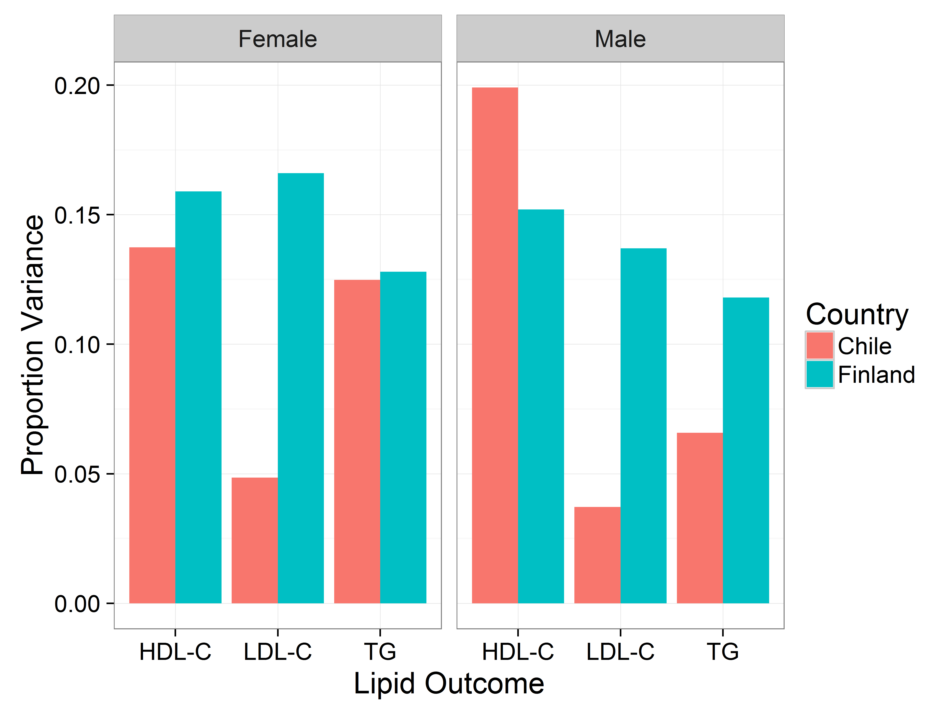
Results
Explained variance by gender and country

Slide 15
Results
Candidate single variant tests of association
Association between single variants and and serum lipid levels, additive model
rsid | Trait | Ref/Min allele | MAF | Effect (se) | p-value
rs1532085 | HDL-C | G/A | 0.33 | 0.053 (0.038) | 0.1655
rs3764261 | HDL-C | C/A | 0.31 | 0.158 (0.04) | 1e-04
rs6511720 | LDL-C | G/T | 0.07 | -0.013 (0.158) | 0.9318
rs1260326 | TG | C/T | 0.31 | 0.36 (0.15) | 0.0165
rs964184 | TG | C/G | 0.37 | 0.326 (0.148) | 0.0277
rs6511720 | TC | G/T | 0.07 | 0.125 (0.165) | 0.4481
For each significant variant, direction of effect matched the multiethnic adult GWAS from which SNPs were selected.

Slide 16
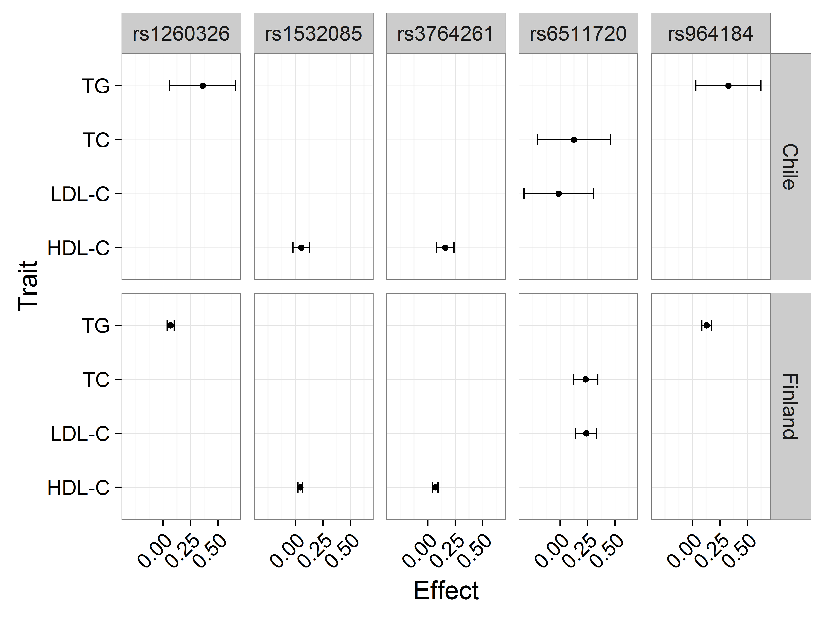
Results
Candidate single variant tests of association by variant and country

Slide 18
Results: Polygenic risk score (PRS) regression coefficients
Association between the genetic risk score and serum lipid levels, coefficient (SE)
Female Male
Outcome/trait | Not adjusted | Adjusted for BMI |  | Not adjusted | Adjusted for BMI
HDL | 0.13 (0.03) | 0.13 (0.03) |  | 0.14 (0.04) | 0.14 (0.04)
LDL | 0.16 (0.08) | 0.17 (0.08) |  | 0.23 (0.08) | 0.24 (0.08)
TG | 0.34 (0.15) | 0.08 (0.02) |  | 0.24 (0.13) | 0.05 (0.02)
All estimates significant at
level of 0.05 with the exception of TG levels for males.

Slide 19
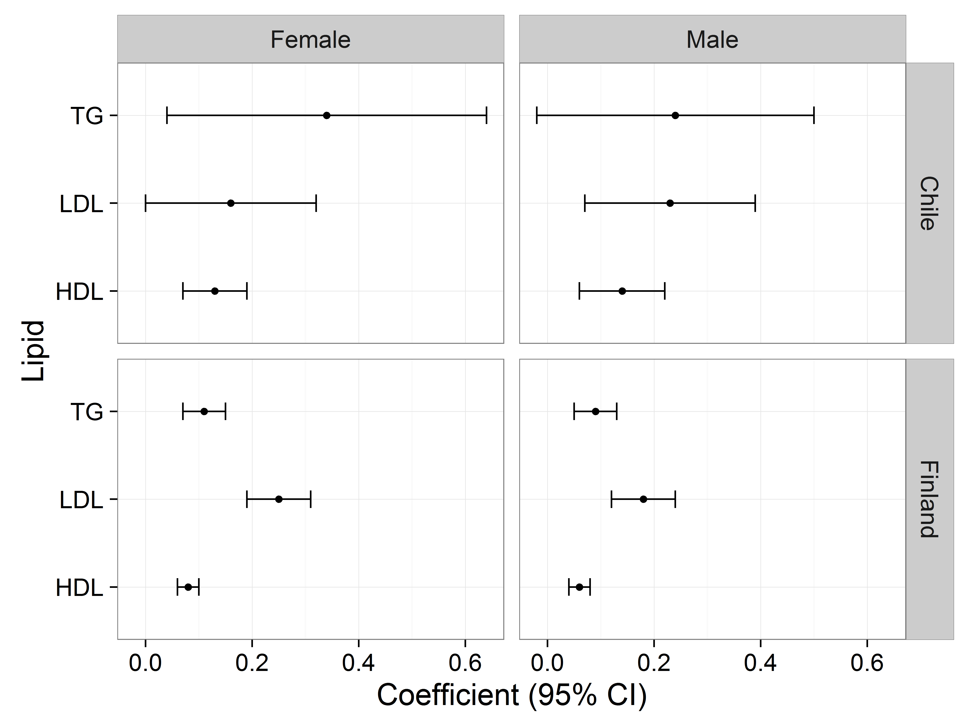
Results: Polygenic risk score (PRS) regression coefficients (no adjustment for BMI) by country and gender

Slide 21
Conclusion
Evidence for associations
There is evidence that lipid loci from a HL sample of adolescents contain similar associations as those from European children and adults.
Despite the small sample size and possibility for bias with different ancestral groups we found meaningful and statistically significant associations relating lipid loci in a HL cohort of Chilean adolescents with those found in European ancestral groups.
These associations emphasize the importance of adolescence as a time for disease prevention given studies demonstrating both the persistence of associations between PRS and lipids over the life course and the increasing role PRS plays in predicting disease.

Slide 22
Extra slides, estimates from Tikkanen et al. (Tikkanen et al. 2011)
Descriptive statistics
Descriptive statistics
Outcome/Trait |  | Female |  | Male
N |  | 661 |  | 555
TG (log(mmol/l)) |  | 0.90 (0.37) |  | 0.91 (0.39)
LDL-C (mmol/l) |  | 3.07 (0.79) |  | 2.91 (0.79)
HDL-C (mmol/l) |  | 1.55 (0.29) |  | 1.34 (0.24)
TC (mmol/l) |  | 5.02 (0.89) |  | 4.67 (0.84)

Slide 23
Extra slides, estimates from Tikkanen et al. (Tikkanen et al. 2011)
Proportion variance explained by lipid variants
Proportion of lipid traits variance explained by lipid-related variants, by gender
Gender | HDL-C | LDL-C | TG
Female | 0.159 | 0.166 | 0.128
Male | 0.152 | 0.137 | 0.118

Slide 24
Extra slides, estimates from Tikkanen et al. (Tikkanen et al. 2011)
Single variant association tests
Association between the genetic risk score and serum lipid levels, coefficient (SE)
rs id | Trait | Effect (se) | Locus | p-value
rs3764261 | HDL-C | 0.0676 (0.012) | CETP | 1.5e-08
rs1532085 | HDL-C | 0.0435 (0.011) | LIPC | 6.9e-05
rs6511720 | LDL-C | 0.2370 (0.048) | LDLR | 7.1e-07
rs1260326 | TG | 0.0693 (0.016) | GCKR | 1.7e-05
rs964184 | TG | 0.1278 (0.022) | APOA1-C3-A4-A5 | 5.8e-09
rs6511720 | TC | 0.2320 (0.055) | LDLR | 2.2e-05

Slide 25
Extra slides, estimates from Tikkanen et al. (Tikkanen et al. 2011)
Polygenic risk score
Association between the genetic risk score and serum lipid levels, coefficient (SE)
 | Outcome/Trait |  | Female |  | Male
HDL |  |  | 0.08 (0.01) |  | 0.06 (0.01)
LDL |  |  | 0.25 (0.03) |  | 0.18 (0.03)
TG |  |  | 0.11 (0.02) |  | 0.09 (0.02)

Slide 26
Extra slides: effect sizes used in PRS from Teslovich et al. 2010 (T. M. Teslovich et al. 2010).
Locus | Chr | Lead SNP | Lead trait | Other traits | Alleles/MAF | Effect size
LDLRAP1 | 1 | rs12027135 | TC | LDL | T/A/0.45 | -1.22
PABPC4 | 1 | rs4660293 | HDL |  | A/G/0.23 | -0.48
PCSK9 | 1 | rs2479409 | LDL | TC | A/G/0.30 | 2.01
ANGPTL3 | 1 | rs2131925 | TG | TC, LDL | T/G/0.32 | -4.94
EVI5 | 1 | rs7515577 | TC |  | A/C/0.21 | -1.18
SORT1 | 1 | rs629301 | LDL | TC | T/G/0.22 | -5.65
ZNF648 | 1 | rs1689800 | HDL |  | A/G/0.35 | -0.47
MOSC1 | 1 | rs2642442 | TC | LDL | T/C/0.32 | -1.39
GALNT2 | 1 | rs4846914 | HDL | TG | A/G/0.40 | -0.61
IRF2BP2 | 1 | rs514230 | TC | LDL | T/A/0.48 | -1.36
APOB | 2 | rs1367117 | LDL | TC | G/A/0.30 | 4.05
 | NA | rs1042034 | TG | HDL | T/C/0.22 | -5.99
GCKR | 2 | rs1260326 | TG | TC | C/T/0.41 | 8.76
ABCG5/8 | 2 | rs4299376 | LDL | TC | T/G/0.30 | 2.75
RAB3GAP1 | 2 | rs7570971 | TC |  | C/A/0.34 | 1.25
COBLL1 | 2 | rs10195252 | TG |  | T/C/0.40 | -2.01
 | NA | rs12328675 | HDL |  | T/C/0.13 | 0.68
IRS1 | 2 | rs2972146 | HDL | TG | T/G/0.37 | 0.46
RAF1 | 3 | rs2290159 | TC |  | G/C/0.22 | -1.42
MSL2L1 | 3 | rs645040 | TG |  | T/G/0.22 | -2.22

Slide 27
Locus | Chr | Lead SNP | Lead trait | Other traits | Alleles/MAF | Effect size
KLHL8 | 4 | rs442177 | TG |  | T/G/0.41 | -2.25
SLC39A8 | 4 | rs13107325 | HDL |  | C/T/0.07 | -0.84
ARL15 | 5 | rs6450176 | HDL |  | G/A/0.26 | -0.49
MAP3K1 | 5 | rs9686661 | TG |  | C/T/0.20 | 2.57
HMGCR | 5 | rs12916 | TC | LDL | T/C/0.39 | 2.84
TIMD4 | 5 | rs6882076 | TC | LDL, TG | C/T/0.35 | -1.98
MYLIP | 6 | rs3757354 | LDL | TC | C/T/0.22 | -1.43
HFE | 6 | rs1800562 | LDL | TC | G/A/0.06 | -2.22
HLA | 6 | rs3177928 | TC | LDL | G/A/0.16 | 2.31
 | NA | rs2247056 | TG |  | C/T/0.25 | -2.99
C6orf106 | 6 | rs2814944 | HDL |  | G/A/0.16 | -0.49
 | NA | rs2814982 | TC |  | C/T/0.11 | -1.86
FRK | 6 | rs9488822 | TC | LDL | A/T/0.35 | -1.18
CITED2 | 6 | rs605066 | HDL |  | T/C/0.42 | -0.39
LPA | 6 | rs1564348 | LDL | TC | T/C/0.17 | -0.56
 | NA | rs1084651 | HDL |  | G/A/0.16 | 1.95
DNAH11 | 7 | rs12670798 | TC | LDL | T/C/0.23 | 1.43
NPC1L1 | 7 | rs2072183 | TC | LDL | G/C/0.25 | 2.01
TYW1B | 7 | rs13238203 | TG |  | C/T/0.04 | -7.91
MLXIPL | 7 | rs17145738 | TG | HDL | C/T/0.12 | -9.32
KLF14 | 7 | rs4731702 | HDL |  | C/T/0.48 | 0.59
PPP1R3B | 8 | rs9987289 | HDL | TC, LDL | G/A/0.09 | -1.21
PINX1 | 8 | rs11776767 | TG |  | G/C/0.37 | 2.01

Slide 28
Locus | Chr | Lead SNP | Lead trait | Other traits | Alleles/MAF | Effect size
NAT2 | 8 | rs1495741 | TG | TC | A/G/0.22 | 2.85
LPL | 8 | rs12678919 | TG | HDL | A/G/0.12 | -13.64
CYP7A1 | 8 | rs2081687 | TC | LDL | C/T/0.35 | 1.23
TRPS1 | 8 | rs2293889 | HDL |  | G/T/0.41 | -0.44
 | NA | rs2737229 | TC |  | A/C/0.30 | -1.11
TRIB1 | 8 | rs2954029 | TG | TC, LDL, HDL | A/T/0.47 | -5.64
PLEC1 | 8 | rs11136341 | LDL | TC | A/G/0.40 | 11.40
TTC39B | 9 | rs581080 | HDL | TC | C/G/0.18 | -0.65
ABCA1 | 9 | rs1883025 | HDL | TC | C/T/0.25 | -0.94
ABO | 9 | rs9411489 | LDL | TC | C/T/0.20 | 2.24
JMJD1C | 10 | rs10761731 | TG |  | A/T/0.43 | -2.38
CYP26A1 | 10 | rs2068888 | TG |  | G/A/0.46 | -2.28
GPAM | 10 | rs2255141 | TC | LDL | G/A/0.30 | 1.14
AMPD3 | 11 | rs2923084 | HDL |  | A/G/0.17 | -0.41
SPTY2D1 | 11 | rs10128711 | TC |  | C/T/0.28 | -1.04
LRP4 | 11 | rs3136441 | HDL |  | T/C/0.15 | 0.78
FADS1-2-3 | 11 | rs174546 | TG | HDL, TC, LDL | C/T/0.34 | 3.82
APOA1 | 11 | rs964184 | TG | TC, HDL, LDL | C/G/0.13 | 16.95
UBASH3B | 11 | rs7941030 | TC | HDL | T/C/0.38 | 0.97
ST3GAL4 | 11 | rs11220462 | LDL | TC | G/A/0.14 | 1.95
PDE3A | 12 | rs7134375 | HDL |  | C/A/0.42 | 10.40
LRP1 | 12 | rs11613352 | TG | HDL | C/T/0.23 | 22.70
MVK | 12 | rs7134594 | HDL |  | T/C/0.47 | -0.44

Slide 29
Locus | Chr | Lead SNP | Lead trait | Other traits | Alleles/MAF | Effect size
BRAP | 12 | rs11065987 | TC | LDL | A/G/0.42 | -0.96
HNF1A | 12 | rs1169288 | TC | LDL | A/C/0.33 | 1.42
SBNO1 | 12 | rs4759375 | HDL |  | C/T/0.06 | 0.86
ZNF664 | 12 | rs4765127 | HDL | TG | G/T/0.34 | 0.44
SCARB1 | 12 | rs838880 | HDL |  | T/C/0.31 | 0.61
NYNRIN | 14 | rs8017377 | LDL |  | G/A/0.47 | 1.14
CAPN3 | 15 | rs2412710 | TG |  | G/A/0.02 | 7.00
FRMD5 | 15 | rs2929282 | TG |  | A/T/0.05 | 5.13
LIPC | 15 | rs1532085 | HDL | TC, TG | G/A/0.39 | 1.45
LACTB | 15 | rs2652834 | HDL |  | G/A/0.20 | -0.39
CTF1 | 16 | rs11649653 | TG |  | C/G/0.40 | -2.13
CETP | 16 | rs3764261 | HDL | TC, LDL, TG | C/A/0.32 | 3.39
LCAT | 16 | rs16942887 | HDL |  | G/A/0.12 | 1.27
HPR | 16 | rs2000999 | TC | LDL | G/A/0.20 | 2.34
CMIP | 16 | rs2925979 | HDL |  | C/T/0.30 | -0.45
STARD3 | 17 | rs11869286 | HDL |  | C/G/0.34 | -0.48
OSBPL7 | 17 | rs7206971 | LDL | TC | G/A/0.49 | 0.78
ABCA8 | 17 | rs4148008 | HDL |  | C/G/0.32 | -0.42
PGS1 | 17 | rs4129767 | HDL |  | A/G/0.49 | -0.39
LIPG | 18 | rs7241918 | HDL | TC | T/G/0.17 | -1.31
MC4R | 18 | rs12967135 | HDL |  | G/A/0.23 | -0.42
ANGPTL4 | 19 | rs7255436 | HDL |  | A/C/0.47 | -0.45
LDLR | 19 | rs6511720 | LDL | TC | G/T/0.11 | -6.99

Slide 30
Locus | Chr | Lead SNP | Lead trait | Other traits | Alleles/MAF | Effect size
LOC55908 | 19 | rs737337 | HDL |  | T/C/0.08 | -0.64
CILP2 | 19 | rs10401969 | TC | TG, LDL | T/C/0.07 | -4.74
APOE | 19 | rs4420638 | LDL | TC, HDL | A/G/0.17 | 7.14
 | NA | rs439401 | TG |  | C/T/0.36 | 25.50
FLJ36070 | 19 | rs492602 | TC |  | A/G/0.49 | 1.27
LILRA3 | 19 | rs386000 | HDL |  | G/C/0.20 | 0.83
ERGIC3 | 20 | rs2277862 | TC |  | C/T/0.15 | -1.19
MAFB | 20 | rs2902940 | TC | LDL | A/G/0.29 | -1.38
TOP1 | 20 | rs6029526 | LDL | TC | T/A/0.47 | 1.39
HNF4A | 20 | rs1800961 | HDL | TC | C/T/0.03 | -1.88
PLTP | 20 | rs6065906 | HDL | TG | T/C/0.18 | -0.93
UBE2L3 | 22 | rs181362 | HDL |  | C/T/0.20 | -0.46
PLA2G6 | 22 | rs5756931 | TG |  | T/C/0.40 | -1.54

Slide 31
Extra slides: Other work
AHA EPI/Lifestyle 2015 Poster: Childhood body mass index (BMI) z-scores associated with low HDL-C levels in adolescence in a Chilean cohort
UNC EPID 726 class presentation in advance of AHA predoctoral (successful) grant application (2016- 2018)
Questions about analyses? Please visit the github web page!
Assistance with slides by Ann Von Holle, doctoral student

Slide 32
References
Buscot, Marie-jeanne, Costan G. Magnussen, Markus Juonala, Niina Pitkänen, Terho Lehtimäki, Jorma S. A. Viikari, Mika Kähönen, et al. 2016. “The Combined Effect of Common Genetic Risk Variants on Circulating Lipoproteins Is Evident in Childhood: A Longitudinal Analysis of the Cardiovascular Risk in Young Finns Study.” Edited by David Fardo. PLOS ONE 11 (1): e0146081. doi:10.1371/journal.pone.0146081.
Carlson, Christopher S., Tara C. Matise, Kari E. North, Christopher A. Haiman, Megan D. Fesinmeyer, Steven Buyske, Fredrick R. Schumacher, et al. 2013. “Generalization and Dilution of Association Results from European GWAS in Populations of Non-European Ancestry: The PAGE Study.” Edited by Greg Gibson. PLoS Biology 11 (9): e1001661. doi:10.1371/journal.pbio.1001661.
Goode, Ellen L., Stacey S. Cherny, Joe C. Christian, Gail P. Jarvik, and Mariza de Andrade. 2007. “Heritability of Longitudinal Measures of Body Mass Index and Lipid and Lipoprotein Levels in Aging Twins.” Twin Research and Human Genetics 10 (5): 703–11. doi:10.1375/twin.10.5.703.
Kwiterovich, Peter O. 2008. “Clinical and Laboratory Assessment of Cardiovascular Risk in Children: Guidelines for Screening, Evaluation, and Treatment.” Journal of Clinical Lipidology 2 (4): 248–66. doi:10.1016/j.jacl.2008.06.003.
Teslovich, Tanya M., Kiran Musunuru, Albert V. Smith, Andrew C. Edmondson, Ioannis M. Stylianou, Masahiro Koseki, James P. Pirruccello, et al. 2010. “Biological, Clinical and Population Relevance of 95 Loci for Blood Lipids.” Nature 466 (7307): 707–13. doi:10.1038/nature09270.
Tikkanen, E., T. Tuovinen, E. Widen, T. Lehtimaki, J. Viikari, M. Kahonen, L. Peltonen, O. T. Raitakari, and S. Ripatti. 2011. “Association of Known Loci with Lipid Levels Among Children and Prediction of Dyslipidemia in Adults.” Circulation: Cardiovascular Genetics 4 (6): 673–80. doi:10.1161/CIRCGENETICS.111.960369.
Willer, Cristen J, Ellen M Schmidt, Sebanti Sengupta, Gina M Peloso, Stefan Gustafsson, Stavroula Kanoni, Andrea Ganna, et al. 2013. “Discovery and Refinement of Loci Associated with Lipid Levels.” Nature Genetics 45 (11): 1274–83. doi:10.1038/ng.2797.

